Slide 1

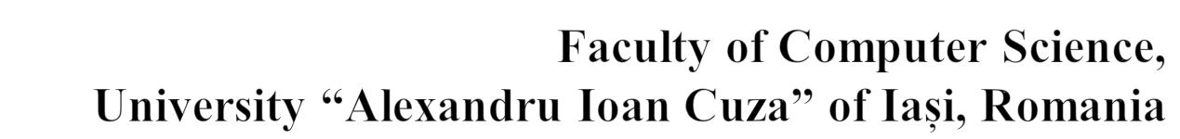

Rareș Chelmuș
rares.chelmus@info.uaic.ro

Slide 2

Business impact - The exponential growth of cryptocoins market in the last year
Social impact - blockchain technologies can change the way society works

Slide 3

Purpose - to predict the variance of the cryptocurrency market using machine learning and NLP algorithms
Motivation - to lower the risks of investing in a new market and to stimulate entrepreneurs that are new in this domain

Slide 4

Economic studies - EMH (Efficient Market Hypothesis) is the hypothesis that the market is really unpredictable.
Linear models like linear regressions were among the first algorithms in the prediction field.
Other linear approaches: autoregressive integrated moving average (ARIMA) and logistical regression.

Slide 5

Sentiment analysis – media articles influence the buy/sell process
Machine learning – Random Forests (RFs)
Neural networks - Long Short Term Memory (LSTM)

Slide 6

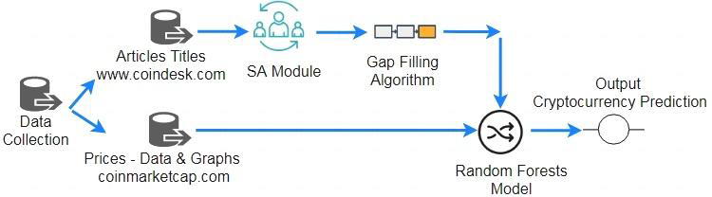

Slide 7

Price chart of the coin
News’ titles table regarding the coin

Slide 8

Date | Close
15/10/17 | 336.6
16/10/17 | 333.38
17/10/17 | 317.08
……….. | ……….
12/01/18 | 1273.2
13/01/18 | 1396.42
14/01/18 | 1366.77

Slide 9
Data | Title
15/10/2017 | Hours to go: How to Watch Ethereum’s Fork as It Happens
16/10/2017 | Bulls Take Breather? Bitcoin Slows as Price Struggles to Breach $6,000
… | …
1/01/2018 | What Will the Bitcoin Price Be in 2017?
02/01/2018 03/01/2018 | Is It Too Late To Buy Bitcoin? Video: $1 Million? Bitcoin Sign Guy on Why It’s Not Too Late to Buy RSK Beta Brings Ethereum-Style Smart Contracts Closer to Bitcoin
04/01/2018 05/01/2018 | Ripple Fever? Other Crypto Assets Are Outpacing Its 2018 Gain Ethereum Price Highs Overshadow New Wave of Tech Issues

Slide 10

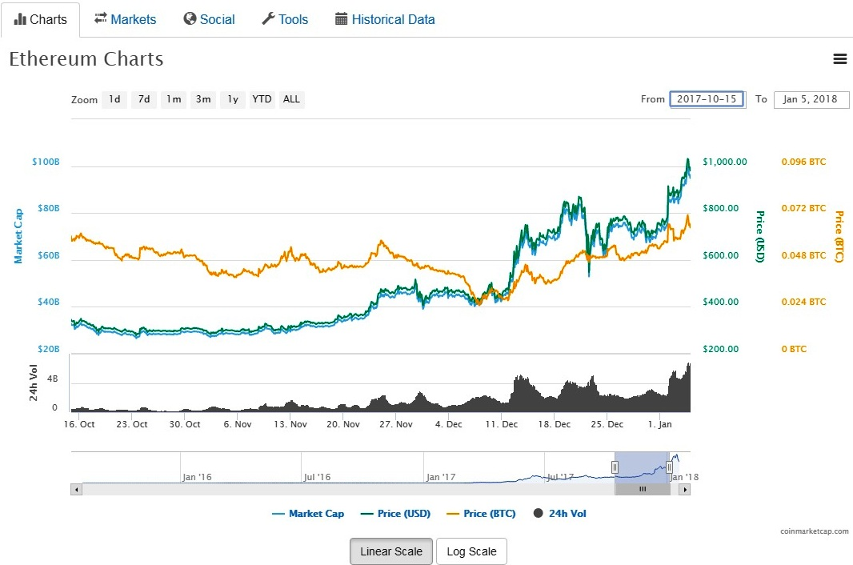
A web crawler gets the price chart of the coin that we want to predict from coinmarketcap.com, extracting the date and the closing price of each day.

Slide 11
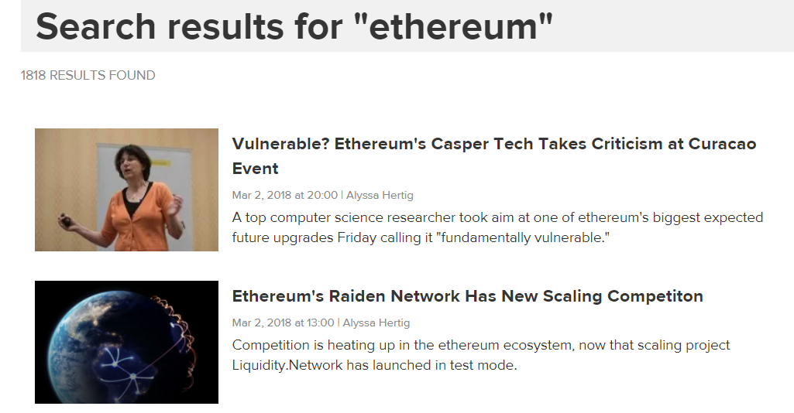
The second crawler will scrape media sites in order to get the news’ heads of the articles that view the coin of choice.

Slide 12

The text data set (news’ titles) are passed through a sentiment analyzer, provided by the NLTK Python library, resulting a table with two columns: date and score.
The table has to be formatted so we can use it in the prediction process.

Slide 13

Data | Scores
15/10/2017 | 0
16/10/2017 | -0.157
16/10/2017 | -0.149
16/10/2017 | 0
17/10/2017 | -0.192
18/10/2017 | 0
18/10/2017 | -0.208
18/10/2017 | 0
26/10/2017 | 0.426
26/10/2017 | -0.216
… | …

Slide 14
Formatting consists of two phases:
  Merging the multiple scores that appear in a single day (there are days where a multitude of articles appear).
  Approximating scores for the blank days (there are many days in which no article was written viewing the selected coin.

Slide 15

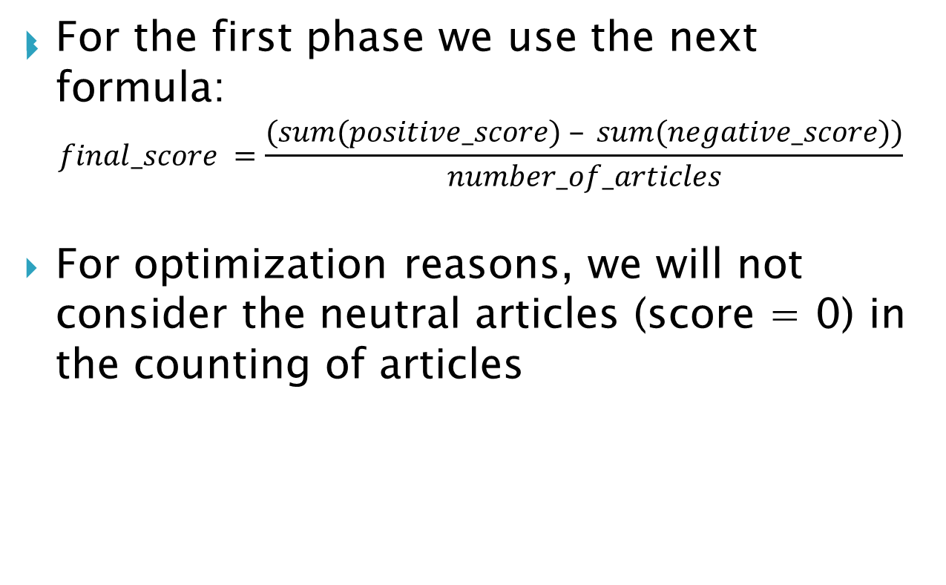

Slide 16

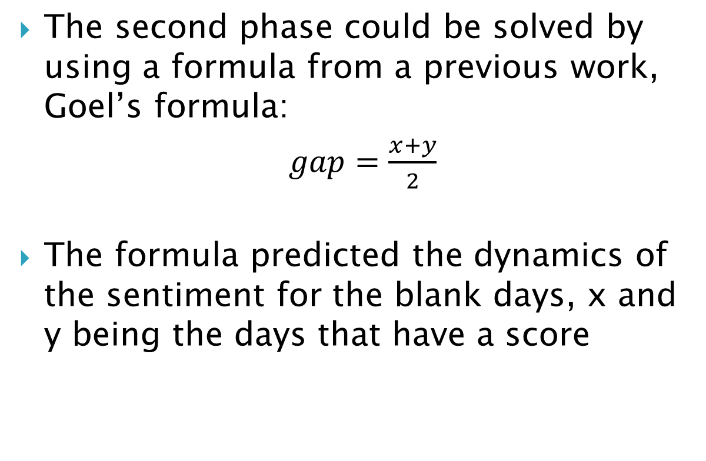

Slide 17

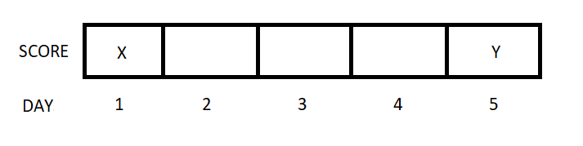

Slide 18

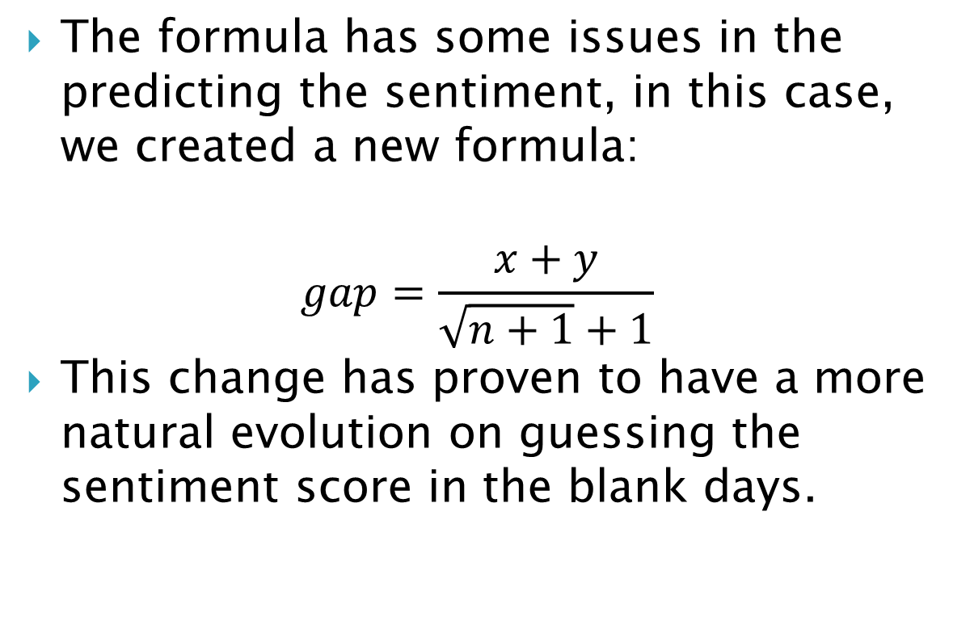

Slide 19

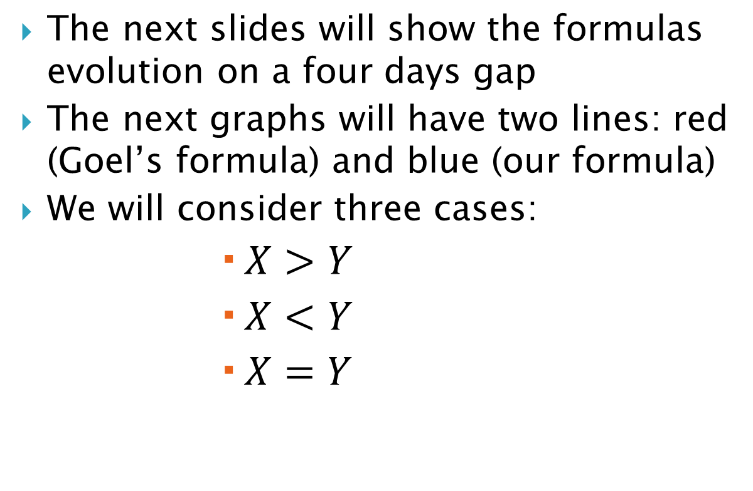

Slide 20

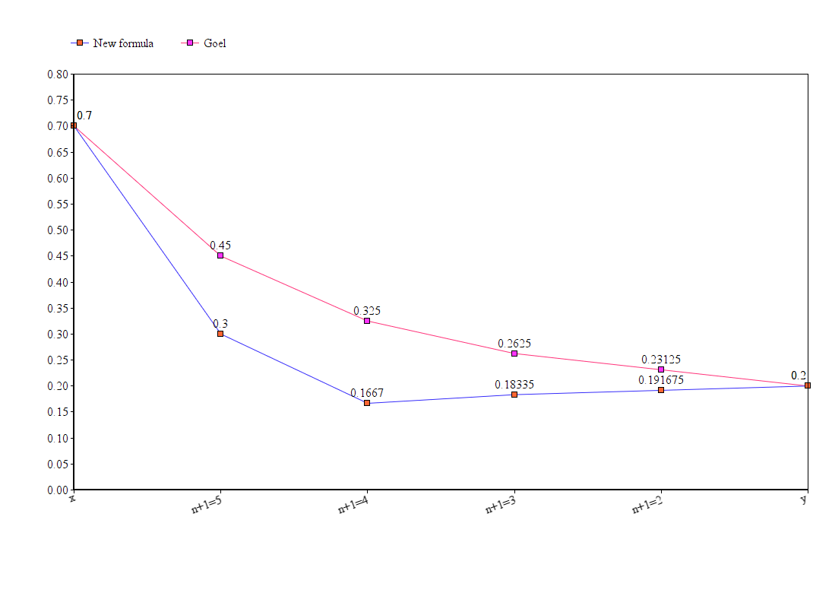

Slide 21

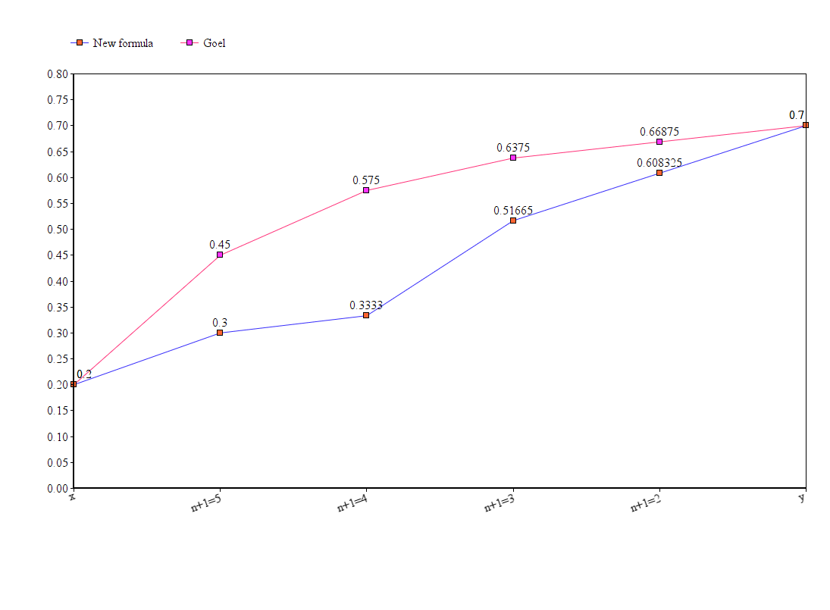

Slide 22

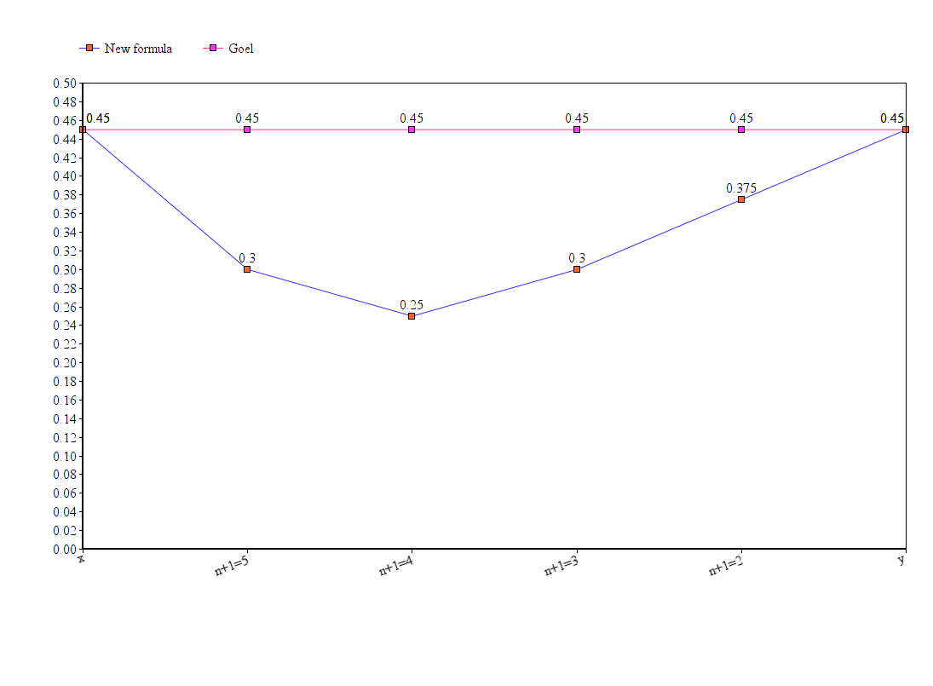

Slide 23

The resulting tables (the price table and the sentiment score table) are merged to create a single data table.
90% is used to train and 10% is for testing.

Slide 24

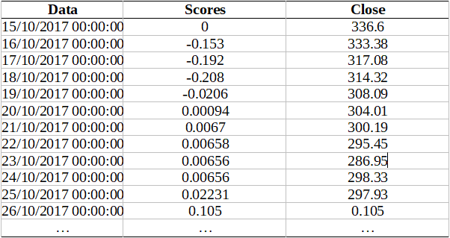

Slide 25

Linear Regression
Random Forest
Random Forest + Sentiment Analysis

Slide 26

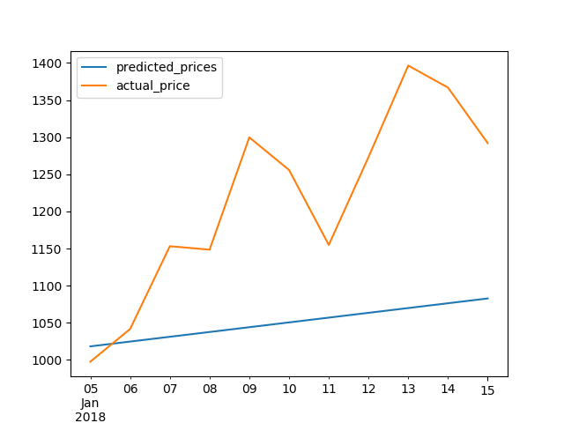
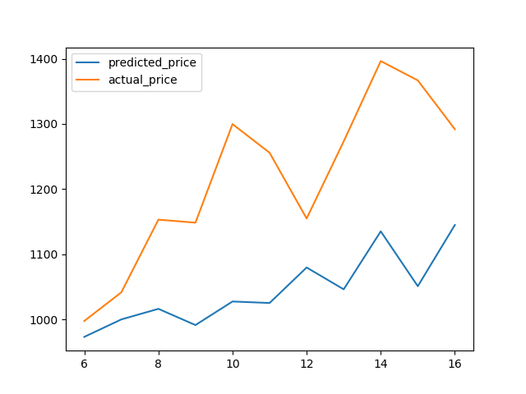
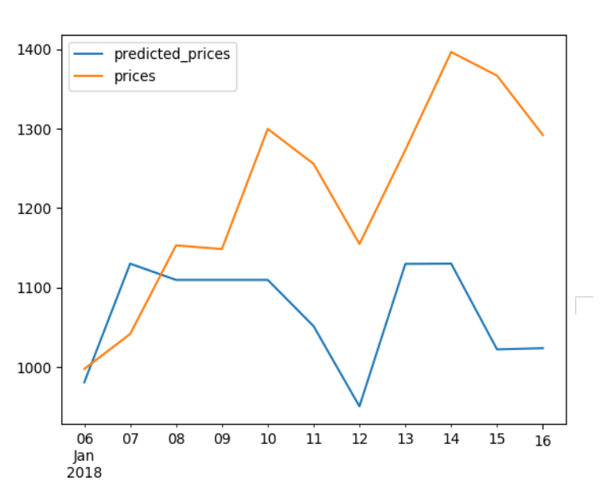

Slide 27

Coin | Model | Precision | Recall | F-measure
 | Random Forest | 75.40% | 65.37% | 66.37%
BTC | Linear Regression | 62.45% | 60.08% | 61.24%
 | SA with Random Forests Development | 75.23% | 73.67% | 74.44%
 | Random Forest | 72.11% | 60.33% | 61.69%
ETH | Linear Regression | 62.71% | 55.11% | 56.85%
 | SA with Random Forests Development | 72.12% | 71.55% | 71.83%
 | Random Forest | 68.23% | 61.42% | 61.32%
XRP | Linear Regression | 59.89% | 54.78% | 55.82%
 | SA with Random Forests Development | 68.45% | 67.01% | 67.72%

Slide 28

Random Forest aided by Sentiment Analysis performs better in this case.
Singularly featured algorithms are unsure for this problem.
Very volatile market – hard to predict.

Slide 29


